Slide 1

DriverPass System Analysis
James Polley
Notes:
[No speaker notes required for this slide.]

Slide 2

System Requirements
Web-based.
Log in to a user account.
Ability to pay for learning packages.
Ability to make, modify, and cancel lessons.
Online courses, exams, and other learning materials.
Good performance with minimal hardware requirements.
Notes:
[In your speaker notes, include an explanation of the different requirements you determined for DriverPass’s system. What are the functional requirements you selected to describe? What are the nonfunctional requirements you selected to describe? Be sure to explain how these requirements meet DriverPass’s needs.]

Slide 3
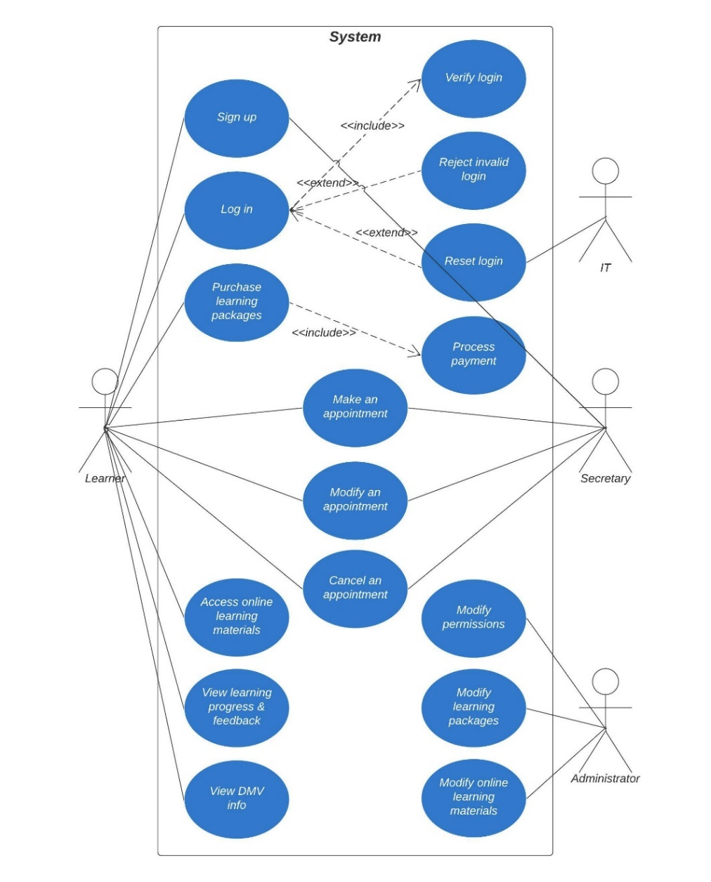
Use Case Diagram
Notes:
[Explain your diagram. Who are the different actors in the system? What are the different use cases? How did you account for DriverPass’s needs in your design? In your explanation, keep your audience in mind. Avoid the use of terms like “actors” and “use cases” in your explanation.]

Slide 4
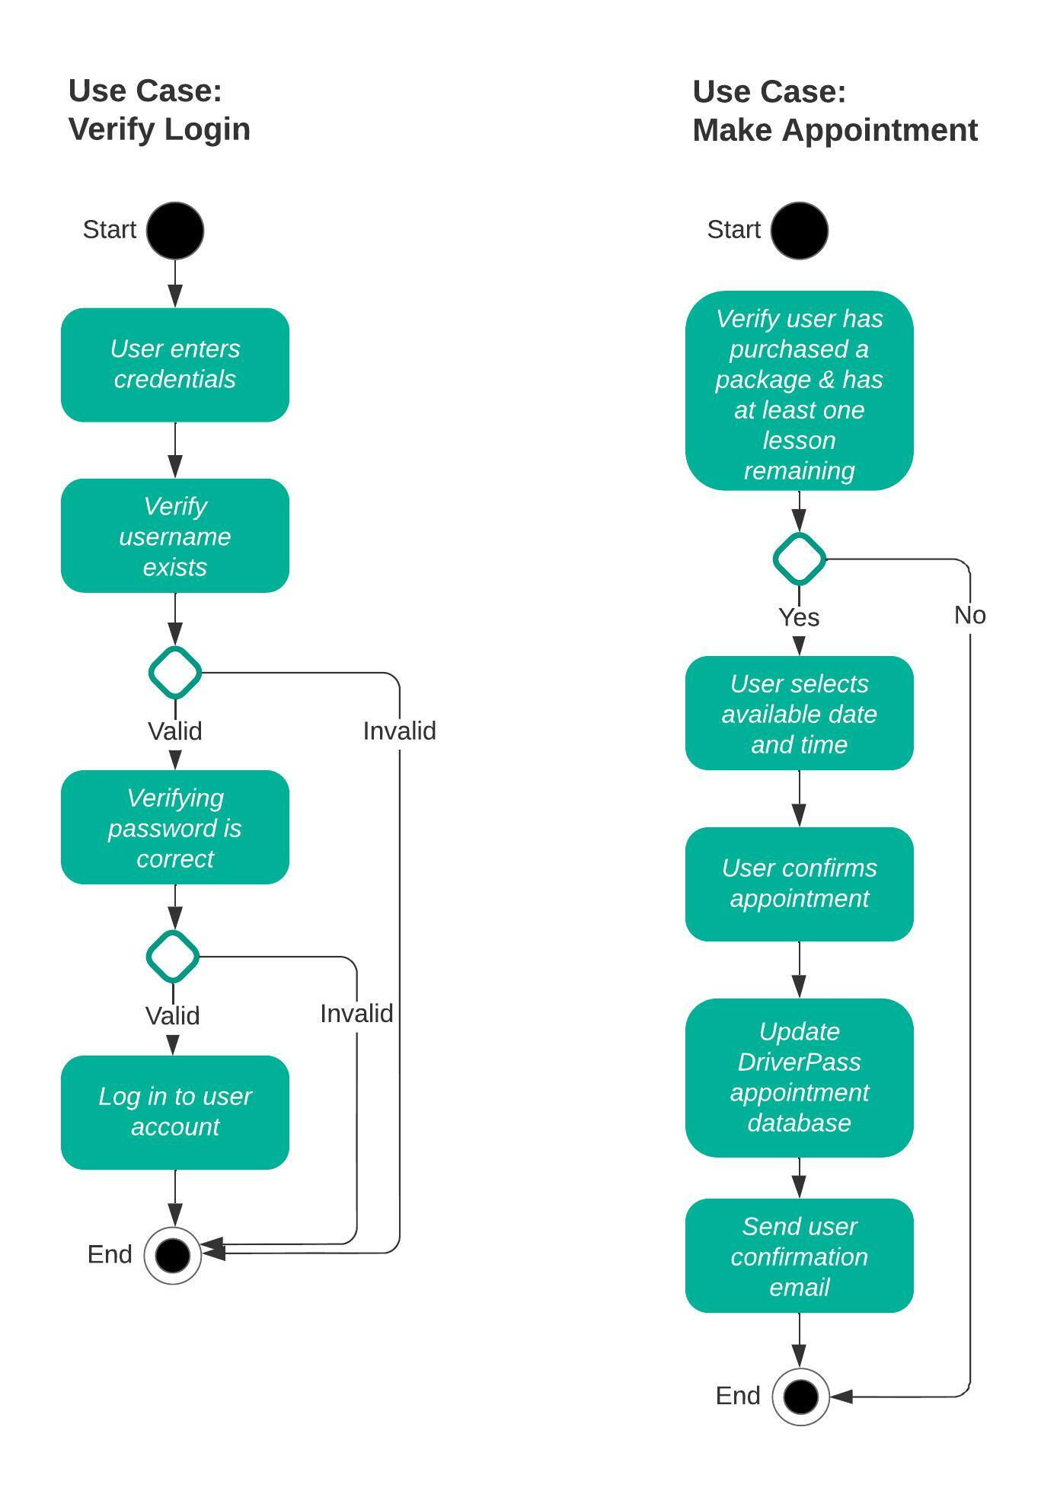
Activity Diagram
Notes:
[Explain your diagram. Which use case are you breaking down? What are the steps for this use case? How did you account for DriverPass’s needs in your design? In your explanation, keep your audience in mind. Avoid the use of technical terms such as “nodes,” “control flows,” and so on.]

Slide 5
Security
Server provider is responsible for security of API calls.
Username and complicated password is required to gain access to user or admin accounts.
Account is temporarily disabled after several invalid logins.
Admin privileges managed and given only to a few.
Notes:
[How did you consider security in your design? In your explanation, keep your audience in mind by avoiding the use of technical terms.]

Slide 6
System Limitations
Unknown budget.
Short timeframe to complete.
Modifications to content will require technical expertise (at first).
Web access is required.
Notes:
[What are the limitations of your design? In your explanation, keep your audience in mind by avoiding the use of technical terms.]

